Slide 1
Lesson 12
The transfiguration
August 5, 2020
Temple Tax/True Greatness/Stumbling Blocks
Matthew 17:24-27;
Matthew 18:1-14; Mark 9:33-50; Luke 9:46-50

Slide 2
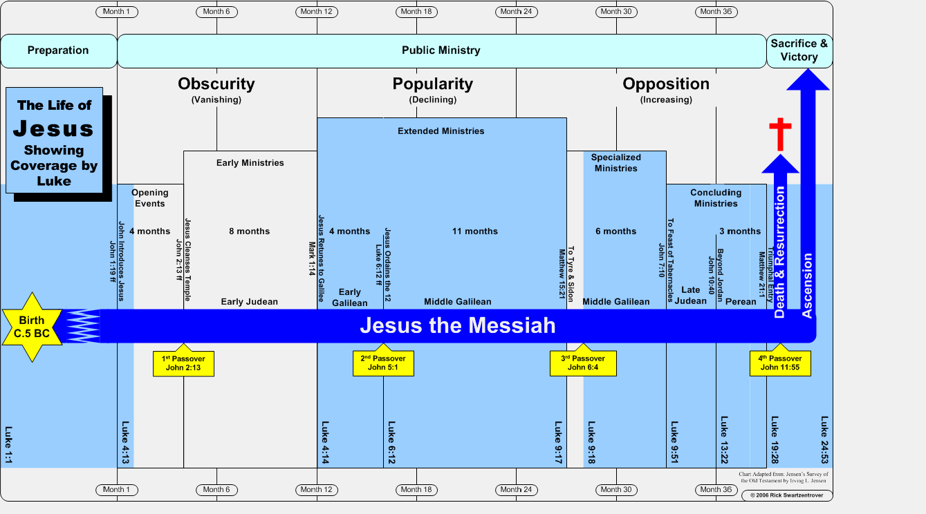
Project analysis slide 2
Timeline of Jesus’ Life

Slide 3
2nd Prediction of Jesus’ Crucifixion
Matthew 17:22-23; Mark 9:30-32; Luke 9:43-45
“From there they went out and began to go through Galilee, and He did not want anyone to know about it. For He was teaching His disciples and telling them, ‘The Son of Man is to be delivered into the hands of men, and they will kill Him; and when He has been killed, He will rise three days later.’” (Mark 9:30-31)
Luke adds before Jesus (2nd) declaration: “Let these words sink into your ears …”
Similar to “He who has ears to hear, let him hear.” (Luke 8:8; 14:35; Revelation 2:7, etc.)
Jesus had just told them in Mark 8:31 before Peter began to rebuke the Lord.
Notes:
Notice the words “to be delivered” are actually in the present tense. “Is being given up or handed over”
Delivered “to deliver over treacherously by way of “betrayal””.
Some of the multitudes, that Jesus didn’t want to know He was passing through, wanted to take Him by force and make Him king a short time earlier. (John 6:15)

Slide 4
2nd Prediction of Jesus’ Crucifixion
Matthew 17:22-23; Mark 9:30-32; Luke 9:43-45
“But they did not understand this statement, and they were afraid to ask Him.” (Mark 9:31)
Luke records, “… it was concealed from them so that they might not perceive it; and they were afraid to ask Him about this statement.” (9:45)
How was it “concealed from them” so that “they did not understand”? (1 Corinthians 2:14-3:3)
Matthew adds: “… and they were deeply grieved.” (Matthew 17:23) Why?
Compare to Peter’s reaction after the first time. (Matthew 16:22; cf. 26:22)
Notes:
It may be that these disciples, in spite of Jesus’ indications otherwise, at least partially shared in the misconceptions that Jesus
would be a king glorified on earth. If that were so, they would have trouble believing that He would be caused to suffer and die at the
hands of the hypocrites He condemned. Not knowing the end from the beginning, they could not comprehend it. (Truth Commentary; Caldwell)
Was that the case, or did God not want them to understand yet? Did He keep them from fathoming it by not fully revealing all the details and reasons? Were they not ready? Was God not ready for them to fully understand His plan? The perfect passive tense of parakaluptō seems to indicate that the hiding came from a source outside themselves (Hendriksen, 517).

Slide 5
Payment of the temple tax
Matthew 17:-24-27
“When they came to Capernaum, those who collected the two-drachma tax came to Peter and said, ‘Does your teacher not pay the two-drachma tax?’ He said, ‘Yes.’” (Matthew17:24-25; Exodus 30:12-16; 2 Chronicles 24:6; Nehemiah 10:32)
“the half-shekel” (ASV), “the tax” (ESV), “the temple tax” (NKJV)
Differing from The “poll tax” – (Matthew 22:17)
Peter’s simple response: “He said, ‘yes’.” (Luke 23:2)
It’s our duty. (Matthew 22:15-21; Romans 13:1-7;
cf. 1 Peter 2:13-17)
Notes:
Return to Capernaum - Jesus’ 2nd home.
From His Messiahship and His church to His glory on the mountain, the conversation now turns to domestic affairs - taxes and the economy.
“When the Romans under Pompey captured Jerusalem in 63 B.C., a tax of 10,000 talents was temporarily imposed on the Jews. The tax-contracting system was reformed by Julius Caesar, who reduced the taxes and levied no tax in the sabbatic years. But soon after the Herods came to power in Palestine, they demanded heavy taxes.
The Herods instituted a poll tax and a tax on fishing rights in the rivers and lakes. Customs were collected on trade routes by men like Levi, who collected in Capernaum (Matt 9:9; Mark 2:14; Luke 5:27). This city may have also been a place for port duties and fishing tolls. Some items sold for 1000 per cent above their original prices because of all the taxes. There may have been sales tax on slaves, oil, clothes, hides, and furs. Over and above these taxes were the religious dues. These were generally between 10 and 20 percent of a person's income before government tax.
During Jesus' time, the Jews were probably paying from 30 to 40 percent of their income on taxes and religious dues.
(Nelson's Illustrated Bible Dictionary)
There was no hesitation by Peter re: Jesus’ practice paying this tax.

Slide 6
Payment of the temple tax
Matthew 17:-24-27
“Each Israelite paid a half shekel as ‘atonement money’ for the service of the tabernacle, the morning and evening sacrifice, the incense, wood, shewbread, red heifers, scapegoat, etc.
(Ex. 30:13). This became an annual payment on the return from Babylon.” (Fausset’s Bible Dictionary)
Notes:
“When the Romans under Pompey captured Jerusalem in 63 B.C., a tax of 10,000 talents was temporarily imposed on the Jews. The tax-contracting system was reformed by Julius Caesar, who reduced the taxes and levied no tax in the sabbatic years. But soon after the Herods came to power in Palestine, they demanded heavy taxes.
The Herods instituted a poll tax and a tax on fishing rights in the rivers and lakes. Customs were collected on trade routes by men like Levi, who collected in Capernaum (Matt 9:9; Mark 2:14; Luke 5:27). This city may have also been a place for port duties and fishing tolls. Some items sold for 1000 per cent above their original prices because of all the taxes. There may have been sales tax on slaves, oil, clothes, hides, and furs. Over and above these taxes were the religious dues. These were generally between 10 and 20 percent of a person's income before government tax.
During Jesus' time, the Jews were probably paying from 30 to 40 percent of their income on taxes and religious dues.
(Nelson's Illustrated Bible Dictionary)
There was no hesitation by Peter re: Jesus’

Slide 7
Payment of the temple tax
Matthew 17:-24-27
“And when he came into the house, Jesus spoke to him first, saying, ‘What do you think, Simon? From whom do the kings of the earth collect customs or poll-tax, from their sons or from strangers?’” (Matthew 17:25)
The practice at that time was that the burden of taxation was generally placed upon foreigners.
“Peter said, ‘From strangers.” (verse 26)
“Jesus said to him, ‘Then the sons are exempt.’”
Jesus, speaking of this religious duty, aligns Himself with “their sons” in the previous verse as the Father’s “beloved Son” (Matthew 17:5), as one exempt from this religious tax.
Notes:
Unlike a modern income tax of citizens, or a sales tax of all inhabitants, Jesus draws attention to the practice of many ancient nations to collect taxes from strangers (t□n allotri□n) rather than their own children (t□n hui□n aut□n)—probably used here in the sense of citizens or royal family. Jesus asked Peter what the general practice was in his day. In our time, principles of fairness and equality regulate and monitor nepotistic practices that might allow the children of officials to benefit financially from a relative’s office. Such concerns were not taken into account by ancient rulers. Family and even citizens, received special treatment in such cultures.

Slide 8
Payment of the temple tax
Matthew 17:-24-27
Jesus continued, “However, so that we do not offend them, go to the sea and throw in a hook, and take the first fish that comes up; and when you open its mouth, you will find a shekel. Take that and give it to them for you and Me.” (Matthew 17:27)
“Offend” – Literally, “cause to stumble.” From skandalizo (Matthew 15:12; John 6:61; 1 Peter 2:15)
A lesson: on insistence of our “rights”:
cf. 1 Corinthians 10:23-24.
A reminder: of who He is (the Son of God) by the means of how the tax was paid.
Notes:
Jesus recognized the impact on not paying this temple tax on those critical of the gospel and His kingdom.
Jesus didn’t want cause offense to His cause over a right of His.
Is this a miracle (in the strict definition of the word)? Or a measure of God’s divine providence. Reminds me of Jesus’ direction to His disciples before entering Jerusalem. (Mark 14:12-16)
Note what Jesus was willing to be scandalous vs. what He wasn’t’. He didn’t change His teaching in John 6 in order to not offend. Here, Jesus silences the ignorance of foolish men (1 Peter 2:15) and establishing who He is at the same time.
Jesus directs Peter to take an ordinary step to provide this tax in a miraculous way.
Jesus teaches on how to avoid a scandal!

Slide 9
True greatness and stumbling Blocks
Matthew 18:1-14; Mark 9:33-50; Luke 9:46-50
“They came to Capernaum; and when He was in the house, He began to question them, ‘What were you discussing on the way?’” (Mark 9:33)
Luke tells us: “And an argument started among them as to which of them might be the greatest.” (Luke 9:46; cf. Luke 22:24ff)
“They kept silent for on the way they had discussed … which of them was the greatest.”
(Mark 9:34)
“Jesus, knowing what they were thinking in their heart …” (Luke 9:47)
Notes:
So, to put this into context, if the apostles had to “get behind Me”, (Matt. 16:23 then they were going to focus on who was first behind Jesus.
An argument “Started” - footnote, lit. “entered in” - who do you suppose introduced that into their hearts? Acts 5:3j
Jesus is trying to focus their minds on His suffering and death and they’re thinking about their preeminence among their peers.
What do their words represent? What’s in their heart. Matthew 15:18-19
Be careful about comparing ourselves to others: 2 Cor. 10:12

Slide 10
True greatness and stumbling Blocks
Matthew 18:1-14; Mark 9:33-50; Luke 9:46-50
What was Jesus’ response?
“Sitting down, He called the twelve and said to them, ‘If anyone wants to be first, he shall be last of all and servant of all.’” (Mark 9:35)
“Last” in what sense? (Philippians 2:3-4)
“Servant of all” – who does that include?
If one truly seeks preeminence, it will come through true humility and service.
Notes:
“servant of all” - includes our enemies, those who treat us shamefully. Those who seek to discredit us - as with Paul and the Corinthians.
Not a false sense of humility but a conviction that others are more important and to be served by myself.
Not to be “seen by men” as in Matthew 6.

Slide 11
True greatness and stumbling Blocks
Matthew 18:1-14; Mark 9:33-50; Luke 9:46-50
What was Jesus’ response?
“And He called a child to Himself and set him before them, and said, ‘Truly I say to you, unless you are converted and become like children, you will not enter the kingdom of heaven. Whoever then humbles himself as this child, he is the greatest in the kingdom of heaven.’” (Matthew 18:2-4)
Their entrance into the kingdom was in jeopardy.
They needed to be “converted” or changed in their perspective of themselves. (cf. 1 Corinthians 4:6)
They needed to “humble” themselves. (James 4:6;
1 Peter 5:5-8)
Notes:
More “negative” preaching by Jesus!
Pride and arrogance stand in opposition to agape love. 1 Cor. 13:4
Consider Prov. 16:18-20; “Pride goes before destruction, and a haughty spirit before stumbling. 19 It is better to be humble in spirit with the lowly
Than to divide the spoil with the proud. 20 He who gives attention to the word will find good, and blessed is he who trusts in the Lord.”
.Pride and arrogance are so deceptive (Jer. 49:16) and challenging to see in oneself - even as Jesus described in Matthew 17:5
When thinking of the conversion to take place - I think of the prodigal son in Luke 15 and his willingness to humble himself and offer his life in service to his father.
Hab 2:4 - “Behold, as for the proud one, his soul is not right within him; But the righteous will live by his faith.

Slide 12
True greatness and stumbling Blocks
Matthew 18:1-14; Mark 9:33-50; Luke 9:46-50
Key words Jesus used:
“Last”
“Servant”
“Converted”
“Humble”
“Become like children”

